Slide 1
Understanding the Stealthy BGP Hijacking Risks in the ROV Era
Yihao Chen, Qi Li, Ke Xu, Zhuotao Liu, Jianping Wu
Tsinghua University

Slide 2
Content
BGP Hijacking in the ROV Era: A Real-World Case
Stealthy BGP Hijacking
Empirical Analysis & Insights
Simulation-Based Risk Evaluation
Discussion & Future Work

Slide 3
BGP Hijacking in the ROV Era: A Real-World Case
To 203.127.0.0/16
Target
AS7473
SingTel, SG
AS3758
SingNet Pte Ltd., SG
RPKI: valid
IRR: match
AS37100
SEACOM Ltd., MU
AS6762
TISparkle, IT
ROV
Hijacker?
AS15412
FLAG Telecom, UK
AS4775
Globe Telecoms, PH
AS17894
Innove Comm., PH
RPKI: invalid
IRR: conflict
To 203.127.225.0/24
* First observed: 2023-10-01 Recently observed: 2025-02-05
* While in the form of BGP hijacking, this case is very likely to be caused by misconfiguration; we awaiting response from relevant operators.
AS17894 mis-announces a /24 without RPKI or IRR authorization, while AS3758 is the legitimate origin
ROV-enabled AS37100 discards the invalid route, and thus has the legitimate /16 route only
→ By seeing routing tables, AS37100 and its customers are not aware of the potential hijacking attempt, and tend to believe their traffic be forwarded correctly.
However, legacy AS6762 accepts the illegitimate route, actually forwarding /24 traffic to AS17894
BGP hijacking still succeeds, and becomes less spotted (stealthier), due to the incomplete ROV deployment in the current Internet?

Slide 4
RPKI/ROV in Today’s Internet
ROAs have covered 53.9% IPv4 prefixes and 59.2% IPv6 prefixes*
Yet ROV deployment is presumably limited
APNIC
RoVista
Cloudflare
* Source: https://rpki-monitor.antd.nist.gov/ROV

Slide 5
BGP Hijacking Under Partial ROV deployment
multi-hop
one-hop
Protected
Protected traffic
malicious ann.
benign ann.
ROV
D
E
Target
ROV
A
B
C
F
G
Hijacker
Protected
or Hijacked?
Hijacked traffic
Hijacked
* This is the general topology structure that illustrates how BGP hijacking could succeed despite partial ROV deployment. It does not reflect the whole Inter-AS topology, but only the part that makes the stealthy hijacking scenario possible.

Slide 6
AS A’s Perspective
ROV
D
E
Target
ROV
A
B
C
Expected traffic propagation
F
G
Hijacker
Hijacker invisible (not reachable)
The hijacker is invisible to AS A on the control plane, due to the ROV filtering of AS B
AS A would expect its traffic safely forwarded along the correct path (green)

Slide 7
Global Perspective
ROV
AS C diverts traffic
to the hijacker
D
E
Target
ROV
A
B
C
Actual traffic propagation
(as expected)
F
G
Hijacker
Actual traffic propagation (hijacked)
AS C, however, is not protected by ROV, and diverts traffic to the hijacker, as long as it accepts the prefix (either the target prefix or a subprefix of it) announced by the hijacker.
AS A falls victim to hijacking unknowingly.

Slide 8
Stealthy Hijacking: An Unexpected Consequence
multi-hop
one-hop
Protected
Protected traffic
malicious ann.
benign ann.
ROV
D
E
Target
ROV
A
B
C
F
G
Hijacker
Hijacked traffic
Hijacked (stealthy hijacking)
Hijacked (direct hijacking)
BGP hijacking that is invisible from the victim on the control plane

Slide 9
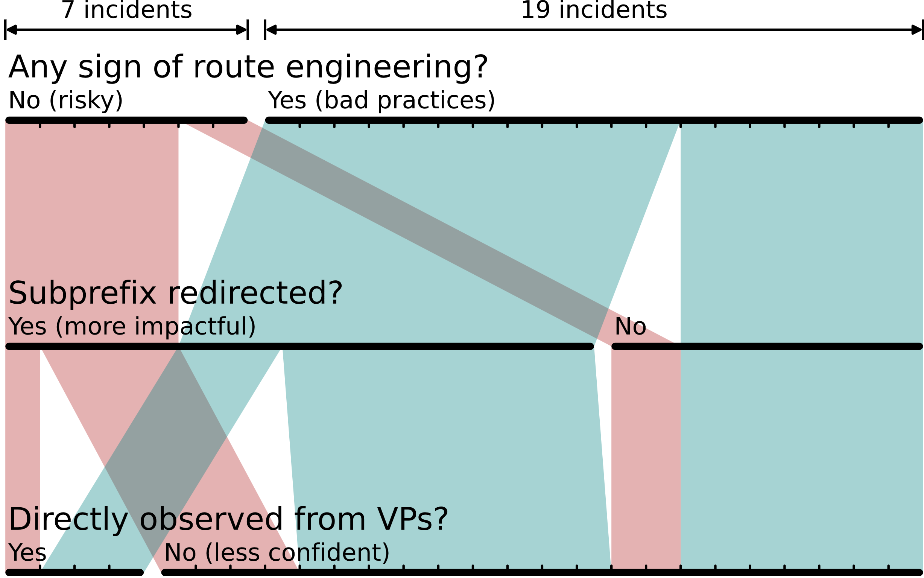
Empirical Analysis of Stealthy Hijacking in the Wild
Data Sources
RIB data from RouteViews collectors (route-views2, amsix, wide) on Oct 1, 2023 (56M routes, 86 vantage points).
Validation: RIPE NCC RPKI, RADB IRR, WHOIS from 5 RIRs, CAIDA AS Organization dataset..
Results
26 incidents: 19 linked to poor route engineering (e.g., outdated RPKI/IRR), 7 potential hijacks.
Affected: 1,205 routes, 40 prefixes, 27 origins.
#0 Most wild stealthy hijacking is caused by bad route engineering practice.

Slide 10
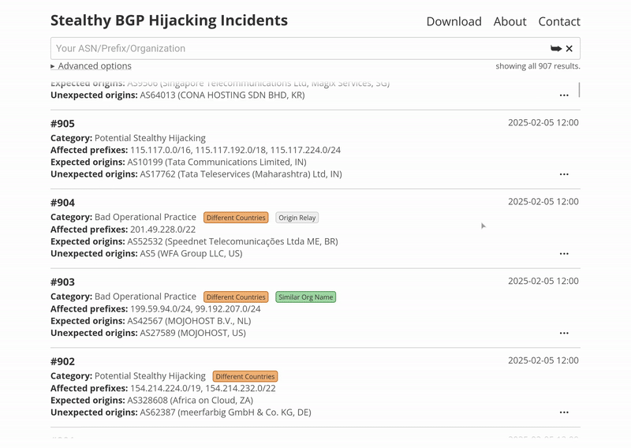
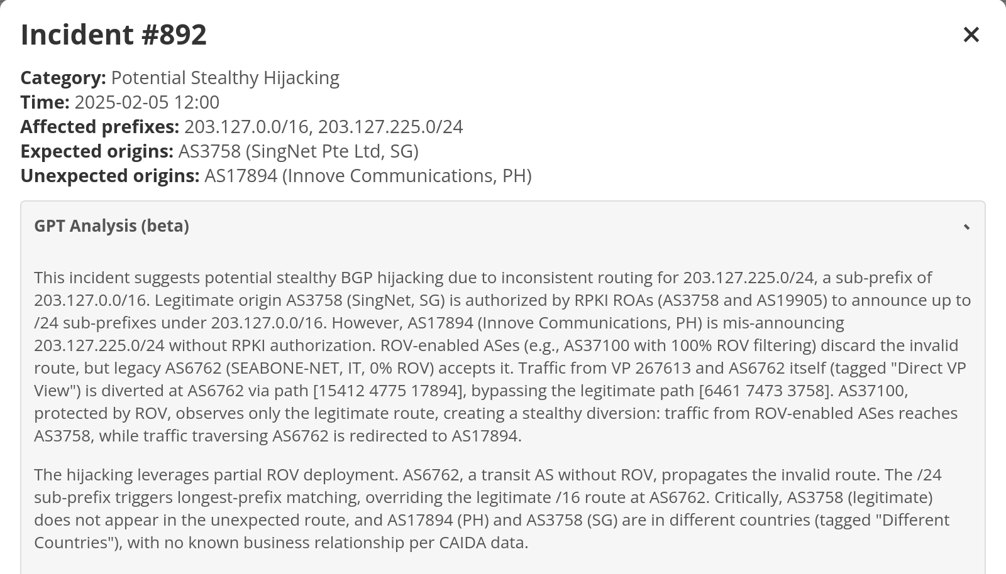
Empirical Analysis: Public Service
Our website to publish stealthy hijacking incidents in the wild:
https://yhchen.cn/stealthy-bgp-hijacking/
Set up search options and date range
Search your interested ASN/prefix/organization
Review the results and feedback
Beta feature: GPT analysis with routing knowledge augmentation
* Daily analysis results since 2025-01-01

Slide 11
Simulation-Based Risk Evaluation
Questions unanswered:
The prevalence, extent, distribution, influencing factors, etc. of the risk within our real-world Internet.
Use CAIDA AS relationships to reconstruct Internet topology
Use APNIC, RoVista, Cloudflare measurement to gain ROV deployment status
Perform BGP simulation on the topology and generate all Internet-scale routes
Thoroughly analyze all possible “victim-target-hijacker” 3-tuple to determine those at risk of stealthy BGP hijacking.
Is it possible to comprehensively evaluate the stealthy hijacking risk introduced by the current ROV deployment?
Challenges: Criteria to identify risk? Knowledge of routes?
Measurement of ROV deployment? ......

Slide 12
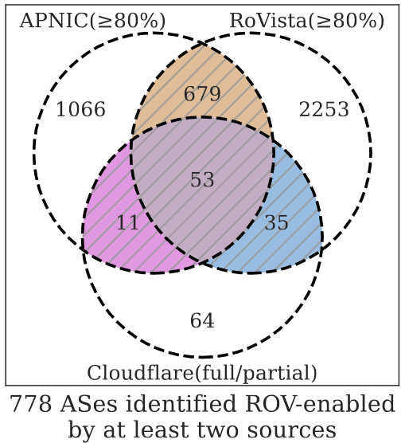
Results: Overall Risk Level
Stealthy Hijacking | Sub-Prefix | Exact-Prefix
w/ ROV | 0.104 | 0.001
w/o ROV | 0.000 | 0.000
▲0.104
▲0.001
Direct Hijacking | Sub-Prefix | Exact-Prefix
w/ ROV | 0.658 | 0.144
w/o ROV | 0.986 | 0.338
▼0.328
▼0.194
#1 The overall success rate of stealthy hijacking increases from 0 to 10.4%, solely due to the partial ROV deployment in today’s Internet.

Slide 13
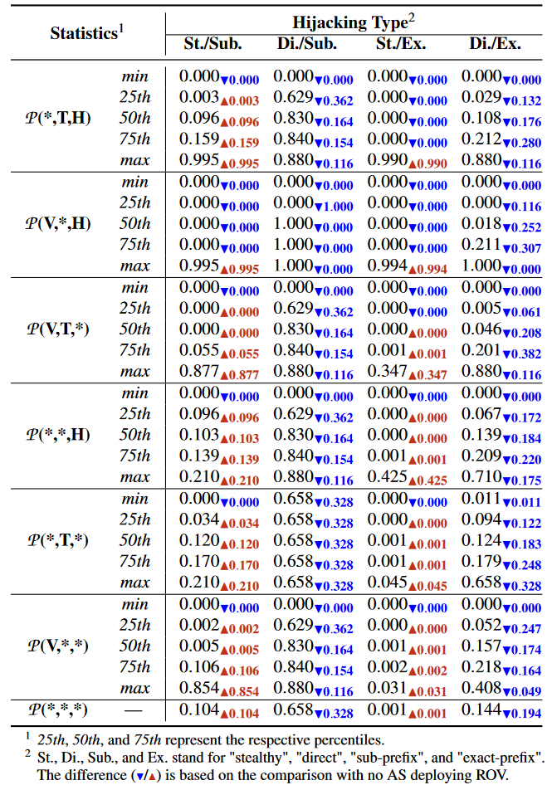
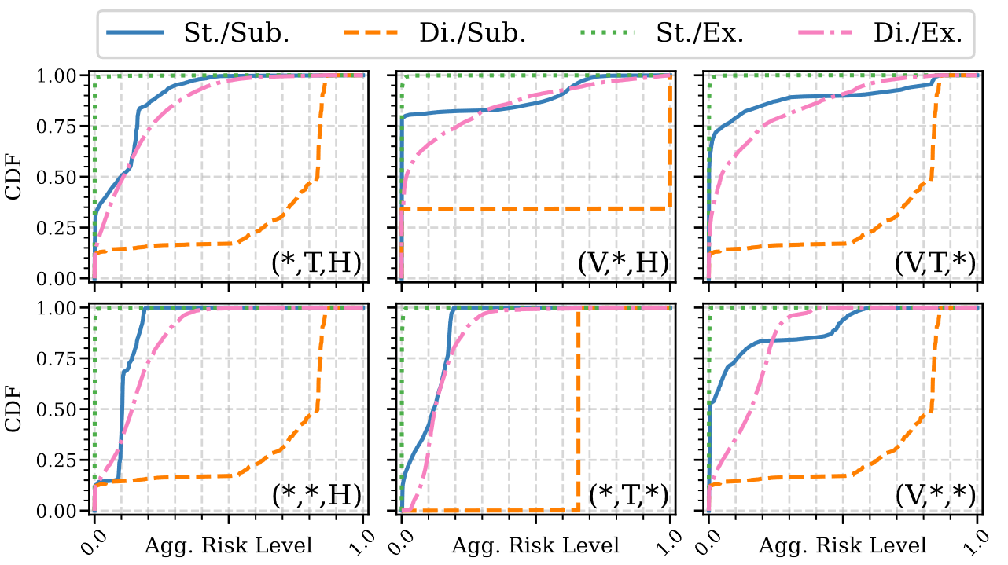
Results: Aggregated Risk Level
#2 Targeted stealthy hijacking has high success rates on specific AS pairs (up to 99.5%), while non-targeted one spreads risk more evenly (within 21.0%).

Slide 14
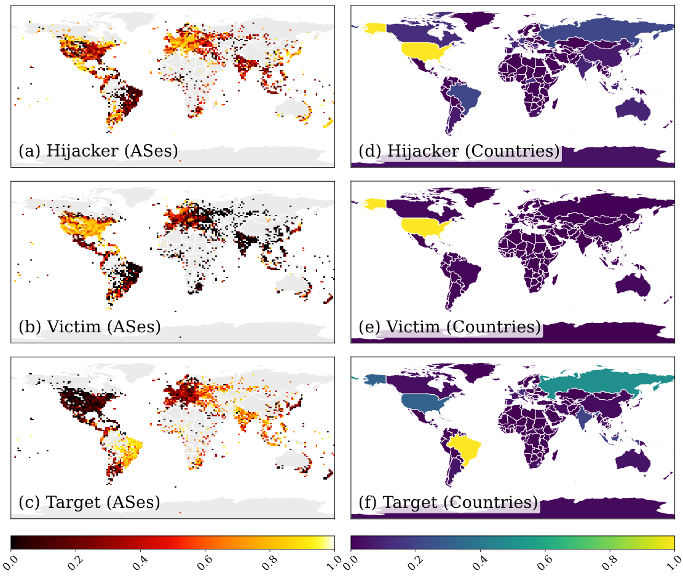
Results: Risk Distribution
#3 Stealthy hijacking risks typically follow an opposing trend to direct hijacking as ROV’s impact increases.
#4 Arguably, ASes most capable of hijacking are mainly in Europe and parts of North America. Victim-prone ASes are mainly in North America. Target-prone ASes are mainly in South America and South Asia.

Slide 15
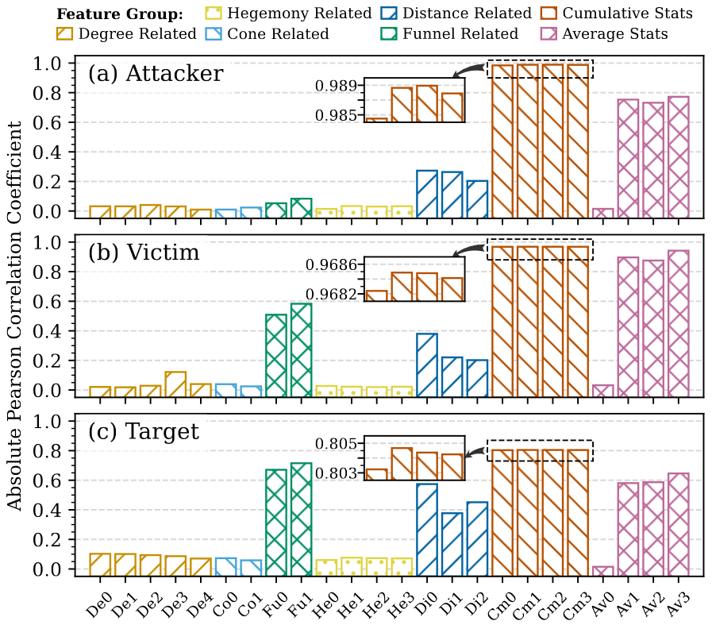
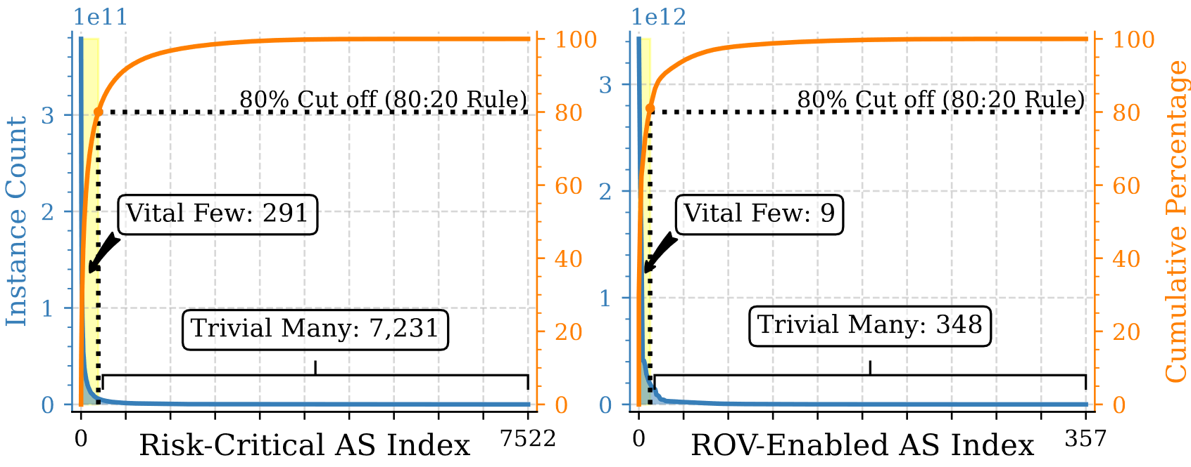
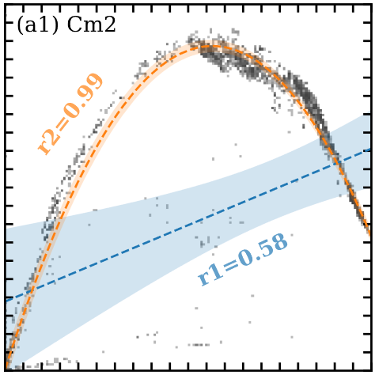
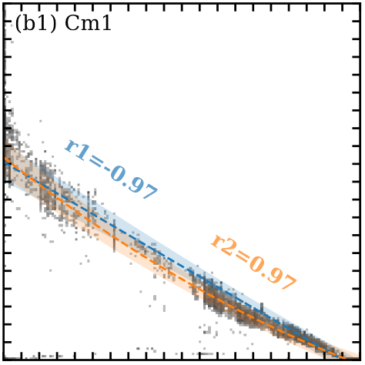
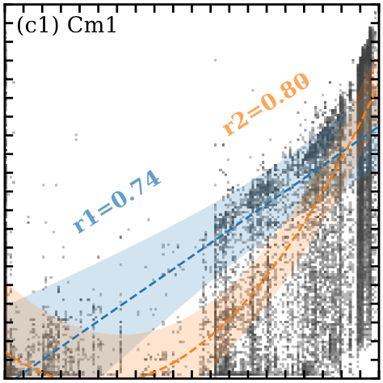
Results: Influencing Factors
#5 Among different features, cumulative statistics of AS hegemony exhibit highest quadratic correlation with the risk.
#6 A small set of risk-critical and ROV-enabled ASes account for the majority of stealthy hijacking risk.

Slide 16
Discussion & Future Work
Limitations of the approach
Prefix-specific routing simulation?
Accuracy-coverage trade-off of ROV cross validation?
Complex routing policy?
Potential practical application
For ISP operation: risk assessment before peering plans
To defend attacks: targeted probing, analysis with real-world routes, ……
Risk countermeasures
Keep increasing RPKI/ROV deployment (as indicated in #3)
Co-analyzing routing data from multiple VP to identify inconsistencies
Collaboration among ROV-enabled ASes to share threat information
Active blackholing on detecting stealthy hijacking (like in ROV++)

Slide 17
Summary
Motivation: a real-world case
Approach: empirical + simulation-based
Evaluation: seven takeaways
Discussion: limitations & future work

Slide 18
Q&A
Thank you!
Key Takeaways
Partial ROV deployment introduces stealthy hijacking risks to the current Internet.
Risk evaluation can be achieved with complete knowledge of routes and ROV deployment.
Our approach cross-validates multiple sources of ROV measurements and infers BGP routes.
A 10.4% success rate of stealthy hijacking is introduced by the current ROV deployment.
Contact: yh-chen21@mails.tsinghua.edu.cn (Yihao Chen)
Online Service: https://yhchen.cn/stealthy-bgp-hijacking/

Slide 19
Appendix: Simulation-Based Analysis Workflow
1
Topology Construction
3
Stealthy Hijacking Analysis
parse
ROV
benign route set
ROV
node set
AS Rel.
ROV
branch
pruning
benign reach
Victim
Target
edge set
malicious
route set
cross
validate
Hijacker
ROV set
discover all stealthy hijacking instances
ROV meas.
Internet topology
core topology
malicious reach
2
“victim-target-hijacker” 3-tuples
Matrix-Based BGP Simulation
None
C2P
P2P
P2C
benign route set
comprehensive analysis results
one-byte
encoding
$$P^{T+1}←update(L,P^{T)}$$
route
restore
malicious
route set
initial states
iterative
matrix update
distrib.
corr.
magn.
geoloc.
final states

Slide 20
Appendix: Gap in Risk Evaluation
ROV++ [Morillo et al, NDSS’21]
Assume unrealistic ROV deployment for experiments.
Evaluate with limited stealthy hijacking samples.
Present overall hijacking rate only.
Questions unanswered:
The prevalence, extent, distribution, influencing factors, etc. of the risk within our real-world Internet.
Is it possible to comprehensively evaluate the stealthy hijacking risk introduced by the current ROV deployment?
Challenges: Criteria to identify risk? Knowledge of routes?
Measurement of ROV deployment? ......

