Slide 1


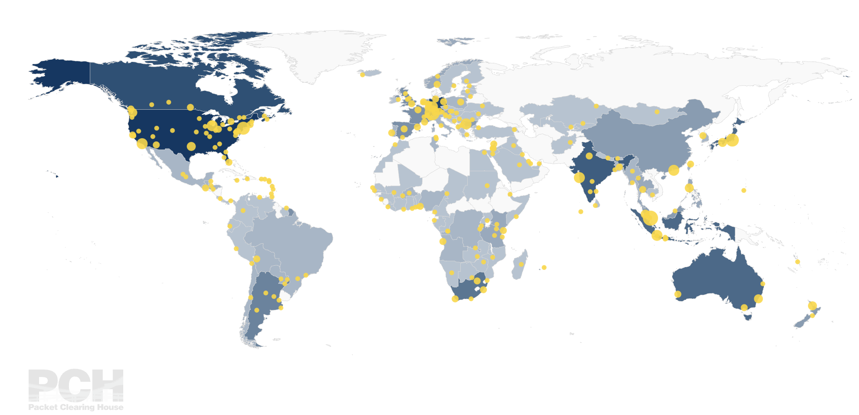
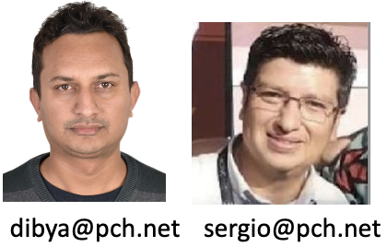
ASN | 42 / 3856
Traffic Profile | DNS Anycast / Research
Traffic Volume | <= 1 Gbps
Peering Policy | Open
Peering Locations | 328 IXPs Globally (Extreme IX (BLR, BOM, DEL), NIXI(BOM, MAA, HYD, DEL), DE-CIX(BOM), Equinix (BOM), KolkataIX
Peeringdb Entry | as42.peeringdb.com / as3856.peeringdb.com
Contact Information | peering@pch.net

